Slide 1

INSTITUTE OF AERONAUTICAL ENGINEERING

Slide 2




Who We Are
Why
To ensure the safety and well-being of individuals by preventing gas-related accidents and potential loss of life
What
We provide a smart and automated gas leakage detection and prevention solution that enables users to remotely monitor and control their gas supply. Our solution includes smart sensors that detect gas leaks and automatically shut off the gas supply, ensuring immediate action to prevent accidents.
How
By installing our smart gas leakage detection system, users can connect the sensors to their gas supply and control it through a mobile application. The sensors continuously monitor the gas levels and detect any signs of leakage. In case of a gas leak, the system sends real-time alerts to the users' smart phones and triggers the automatic shut-off feature, cutting off the gas supply to prevent further leakage. Users can also remotely monitor and control their gas supply through the mobile app, ensuring peace of mind and enhanced safety.

Slide 3
Problem/Opportunity
Context: Busy lifestyle, Forgetfulness | Problem: Many individuals lead busy lives and may forget to perform daily tasks or important safety measures. Lack of reminders and automation Risk of gas leakage and accidents Potential loss of life and property | Alternatives: Be alert and create a checklist before leaving home A responsible member has to be at home to take care of this always. In case of an emergency, nearby hospitals and fire brigades should be informed but this is not the prevention Use gadgets that detect such gas leakage and alert
Customers: Working individuals Hostel students Bachelors | Emotional Impact: Fear, anxiety Concern for safety Peace of mind Quantitative Impact: The fear will get reduced that will lead to good health. More than 60% can save their time as these people are more forgetful as per statistics. Reduce the casualty situation drastically. | Alternative Shortcomings: Manual reminders can be forgotten or ignored: Using manual reminders, such as sticky notes or alarms, may not be reliable as they can be easily overlooked or ignored in the rush of daily activities Hiring someone can be expensive and not scalable: Employing someone to monitor gas supply and safety measures may not be a practical or cost-effective solution, especially for individuals with limited resources or in a shared living setup. Traditional gas safety measures may not be fool proof: Conventional safety mechanisms, such as gas detectors or shut-off valves, may have limitations or be prone to technical failures, compromising their effectiveness in preventing gas accidents.

Slide 4
Customer Interviews And Surveys
11
19
30
said they can solve the problem, they don’t need any new solution
people agree that the problem needs to be solved
customers were interviewed

Slide 5
Survey Questions
# of Interviews conducted = 30
As far we have interviewed 30 members in this we came across
different variety of people like House wife,Bachelors,working
women and Hostelers.
# Interview mode – Online
We have conducted Online interview for a better understanding. We met a few as well. Here we have presented only the online ones
Problem Validation as Must have:
Up to 63% of people has agreeded with us and the
remaining 37% includes those who do not need any such solution
Question | Option 1 | Option 2 | Option 3
What gas leak detection methods have you used in the past? | Traditional methods | Professional gas leak detection | Gas leak detection technology or devices
How satisfied are you with the effectiveness of the gas leak detection methods you have used? | Very satisfied | Somewhat satisfied | Not satisfied
How concerned are you about the safety risks associated with gas leaks in your home or business? | Very concerned | Somewhat concerned | Not concerned
Have you ever experienced a gas leak incident in your home or business? | Yes | No | Not sure
How would you rate the accessibility and availability of gas leak detection services in your area? | Excellent | Average | Poor
How important is it for you to receive real-time notifications/alerts about gas leaks in your home or business? | Very important | Somewhat important | Not important
Are you currently using any smart home or security systems? | Yes | No | Planning to
How likely are you to invest in an advanced gas leak detection system for your home or business? | Very likely | Somewhat likely | Not likely
Survey Questions
Data and Compiled Graphs

Slide 6
Survey Analysis and Results

Slide 7
Survey Analysis and Results

Slide 8
Survey Analysis and Results
Demographic Questions | Responses
Age | 18-24, 25-34, 35-44
Location | City, Suburb, Rural area
Occupation | Student, Professional, Homemaker,

Slide 9
Market Size
TAM (Total Addressable Market) - India:
Total population of India: Approximately 1.38 billion (source: World Bank)
Approximate percentage of households with cooking gas connections: 60% (source: Ministry of Petroleum and Natural Gas)
Assuming each household with a cooking gas connection is a potential customer, we can estimate the TAM as: TAM = Total population * Percentage of households with gas connections TAM = 1.38 billion * 60% TAM ≈ 828 million customers
Niche Segment: 10% of SOM = 7 L
Residential Apartments and Housing Complexes
Many residential apartments and housing complexes in Hyderabad have a centralized gas supply system or multiple individual gas connections within the complex.
These complexes typically have a higher concentration of households in a confined space, making them a potential niche segment for the gas leakage startup.
By focusing on providing gas leakage detection and prevention solutions specifically tailored for residential apartments and housing complexes, the startup can address the unique needs and challenges of this segment.
Please note that we have created our sales funnel using this niche.
TAM
828 M
SAM (Serviceable Addressable Market) - Telangana:
Total population of Telangana: Approximately 39 million (source: Census of India)
Approximate percentage of households with cooking gas connections in Telangana: 65% (assumption)
Assuming each household with a cooking gas connection is a potential customer, we can estimate the SAM as: SAM = Total population of Telangana * Percentage of households with gas connections in Telangana SAM = 39 million * 65% SAM ≈ 25.35 million customers
SAM
25 M
SOM (Serviceable Obtainable Market) - Hyderabad:
Total population of Hyderabad: Approximately 10 million (source: Census of India)
Approximate percentage of households with cooking gas connections in Hyderabad: 70% (assumption)
Assuming each household with a cooking gas connection is a potential customer, we can estimate the SOM as: SOM = Total population of Hyderabad * Percentage of households with gas connections in Hyderabad SOM = 10 million * 70% SOM ≈ 7 million customers
SOM
7 M
Sources:
World Bank: https://databank.worldbank.org/
Ministry of Petroleum and Natural Gas: https://www.petroleum.nic.in/
Census of India: https://censusindia.gov.in/

Slide 10
Customer Segment
Interests and Preferences:
Customers are interested in health and safety.
Individuals seeking to save their time and be more safer.
Customers who prioritize their work more than household chores.
Age Range:
Age Range starts from 20years.
The age range typically includes individuals above 18 years and up to old age people.
Demographic Profile:
Both male and female customers.

Slide 11

Customer Persona
Bio:
Rajesh is a working professional who lives with his wife and two children in an apartment in Hyderabad. He is conscious about the safety and well-being of his family. As a busy individual, he often has a hectic schedule and sometimes forgets to turn off the gas stove before leaving the house. He is looking for a reliable solution that can help him prevent any potential gas leak accidents and provide peace of mind.
Challenges and Pains:
Forgetfulness leading to potential gas leak accidents.
Concerns about the safety of his family and home.
Lack of a reliable and convenient solution for gas leakage detection and prevention.
Difficulty in finding a cost-effective and efficient solution.
Goals and Motivations:
Ensure the safety of his family and home.
Have a convenient and easy-to-use solution for gas leakage detection and prevention.
Reduce the risk of accidents and property damage.
Name: Rajesh Kumar
Age: 35
Occupation: Software Engineer
Location: Hyderabad, India
Safety-conscious: 80%
Tech-savvy: 70%
Convenience-oriented: 90%

Slide 12
Value Proposition Canvas
Increased safety and peace of mind through proactive gas leakage prevention
Convenient and intuitive control of the gas stove from anywhere
Better decision-making with access to gas usage data and insights.
Enhanced safety and peace of mind regarding gas stove usage
Convenience and ease in controlling the gas stove from anywhere
Real-time alerts and notifications to prevent accidents
Access to historical data and insights on gas usage for informed decision-making
.
Smart gas leakage detection sensor and shut-off system
Mobile application for remote control and monitoring
Real-time alerts and notifications
Historical data and insights on gas usage
GAIN CREATORS
GAINS
Ensure the safety of the gas stove and prevent potential gas leaks
Simplify the management and control of the gas stove
Access real-time information and alerts regarding gas usage
PRODUCT/
SERVICE
JOBS
FIT
PAIN KILLERS
PAINS
Early detection of gas leaks and automatic shut-off for enhanced safety
Remote control and monitoring capabilities for convenience and peace of mind
Access to historical data and insights for better gas stove management
Fear of potential gas leaks and associated safety hazards
Busy schedule leading to forgetfulness in turning off the gas stove
Lack of control and monitoring capabilities for the gas stove
Inconvenience in managing gas stove manually

Slide 13








The Lean Canvas
Problem
Solution
Unique Value Proposition
Unfair Advantage
Customer Segments
Smart gas leakage detection sensor and shut-off system
Mobile application for remote control and monitoring
Real time alerts and notifications
Residential households
Commercial kitchens
Restaurants and food establishments
Gas leakage risks
Forgetfulness
Lack of control
Convenient and safe gas stove management with smart technology
Our team is well coordinated and focussed
We are working on the technology.
Key Metrics
Channels
Online marketing and advertising
. Partnerships with gas stove dealers
Social media presence
Number of gas leak incidents prevented
Customer satisfaction rate
Monthly recurring revenue (MRR)
Cost Structure
Revenue Streams
Research and development
Manufacturing and production
Marketing and advertising
Product sales
Subscription services
Maintenance and support fees

Slide 14
Solution and Benefits
Solution: Our solution aims to address the problem of forgetfulness and mitigate the risks associated with neglecting important day-to-day tasks. We propose the development of a smart home automation system equipped with intelligent sensors and automation capabilities. The system will integrate with various household appliances and provide users with an intuitive and automated way to manage and monitor their daily tasks.
Benefits of the Solution:
Increased Safety: By providing timely reminders and automating essential tasks, the solution helps users maintain a safer living environment and reduces the risk of accidents, such as gas leaks or leaving doors unlocked.
Peace of Mind: Users can have peace of mind knowing that their daily tasks are being managed and monitored effectively, even during busy and hectic periods.
Energy and Cost Savings: Automation features can help optimize energy consumption by automatically turning off appliances when not in use, resulting in potential cost savings on utility bills.
Improved Efficiency: The solution streamlines daily routines and eliminates the need for manual checks, saving users time and effort.
Scalability and Adaptability: The system can be expanded and customized to accommodate different user preferences and adapt to changing needs and lifestyles.
Our solution aims to empower individuals to lead safer and more organized lives, providing them with the confidence that their critical tasks are being managed efficiently and effectively.

Slide 15
Competition Analysis
Competitor | Product | Price Range (in Rupees) | Unique Value Proposition (UVP) | Market Review
Nest Protect | smart smoke and carbon monoxide alarm | RS.9,250 | It can send alerts to your smartphone and has the ability to shut off gas valves . | Great product and easy to setup.
Honeywell Lyric Wi-Fi Water Leak and Freeze Detector | sense natural gas leaks | Rs.8,837 | Capability to sense natural gas leaks. | Sends a recording of your smoke or CO detector sounding off
Leeo Smart Alert | monitors smoke and carbon monoxide alarms, | Rs.8,000 | provides real-time notifications. | Really works great and I can view the temperature and humidity
Airthings Wave Plus | air quality monitor | Rs.10,000 | specifically focus on gas leaks | Wave Plus Smart Indoor Air Quality Monitor
INDITECH | Gas leakage sensor | RS. 6000 | Leakage Detection and auto shutoff the gas

Slide 16
Key Features of the Solution:
Task Reminders: The system will offer personalized task reminders to users based on their daily routine and preferences. Users will receive timely notifications and alerts to ensure they remember critical tasks, such as turning off the gas stove, locking doors, or switching off electrical appliances.
Automation and Control: The system will enable automation and control of household appliances. Users can program specific actions, such as automatically turning off the gas stove after a designated time or remotely controlling lights and other devices through a mobile app or voice commands.
Smart Sensors: Intelligent sensors will be installed in key areas of the house to detect and monitor potential hazards or unusual activities. For instance, gas leakage sensors can detect the presence of gas and send immediate alerts to the user's smartphone or trigger automatic shut-off mechanisms.
Mobile Application: A user-friendly mobile application will serve as the central control hub for managing tasks, receiving notifications, and accessing real-time monitoring of the home environment. The app will provide a seamless and intuitive interface for users to interact with the system.
Integration with Voice Assistants: The solution will integrate with popular voice assistants, allowing users to control and manage their tasks using voice commands. This hands-free approach adds convenience and enhances the overall user experience.

Slide 17
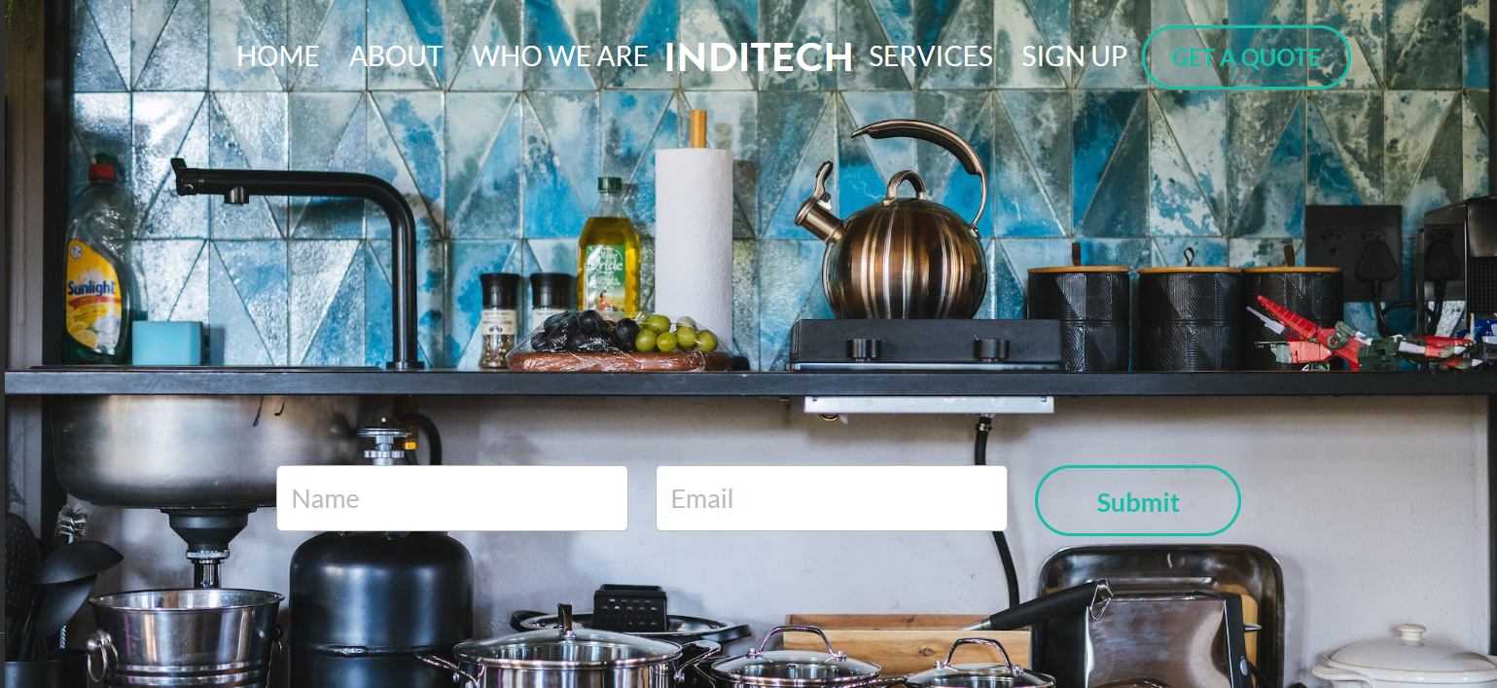
MVP
The MVP is at present is priced at Rs. 7000/- per unit.
Task Reminders: The system will offer personalized task reminders to users based on their daily routine and preferences. Users will receive timely notifications and alerts to ensure they remember critical tasks, such as turning off the gas stove, locking doors, or switching off electrical appliances.
Automation and Control: The system will enable automation and control of household appliances. Users can program specific actions, such as automatically turning off the gas stove after a designated time or remotely controlling lights and other devices through a mobile app or voice commands.
Smart Sensors: Intelligent sensors will be installed in key areas of the house to detect and monitor potential hazards or unusual activities. For instance, gas leakage sensors can detect the presence of gas and send immediate alerts to the user's smartphone or trigger automatic shut-off mechanisms.
Mobile Application: A user-friendly mobile application will serve as the central control hub for managing tasks, receiving notifications, and accessing real-time monitoring of the home environment. The app will provide a seamless and intuitive interface for users to interact with the system.
Integration with Voice Assistants: The solution will integrate with popular voice assistants, allowing users to control and manage their tasks using voice commands. This hands-free approach adds convenience and enhances the overall user experience.
Website Link

Slide 18
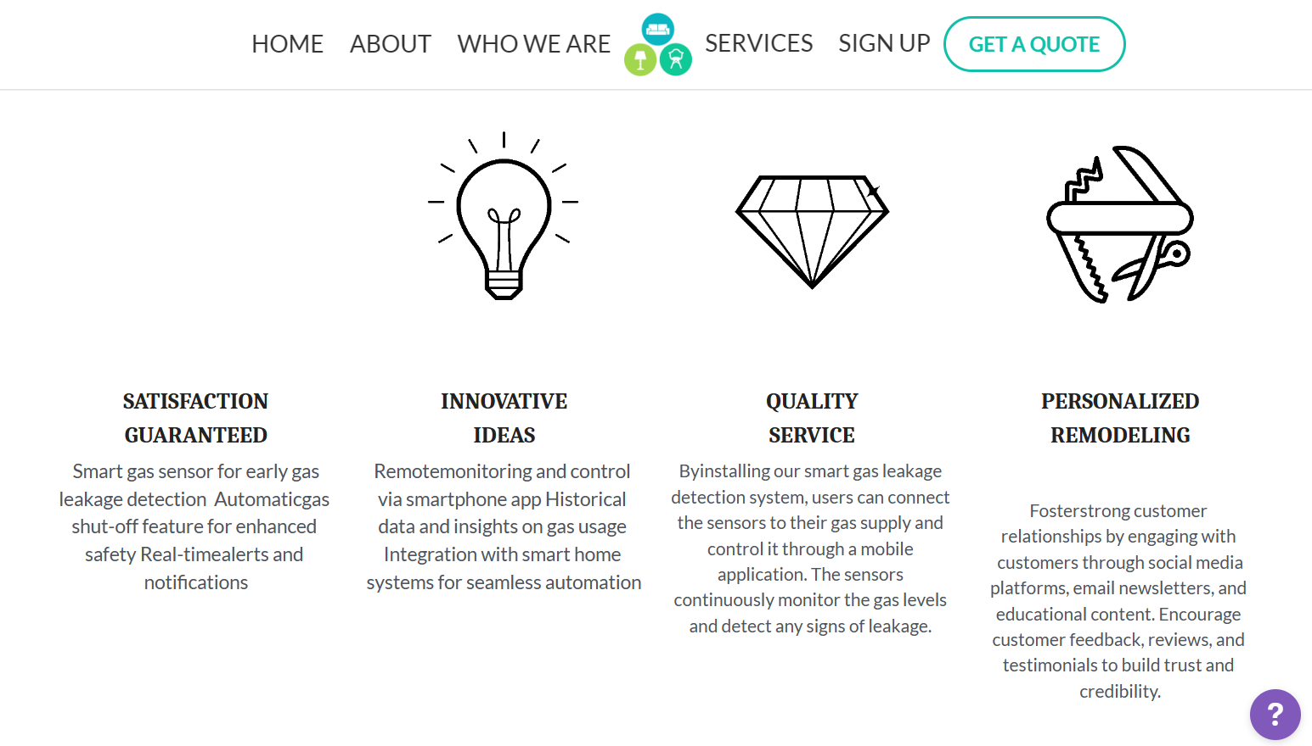
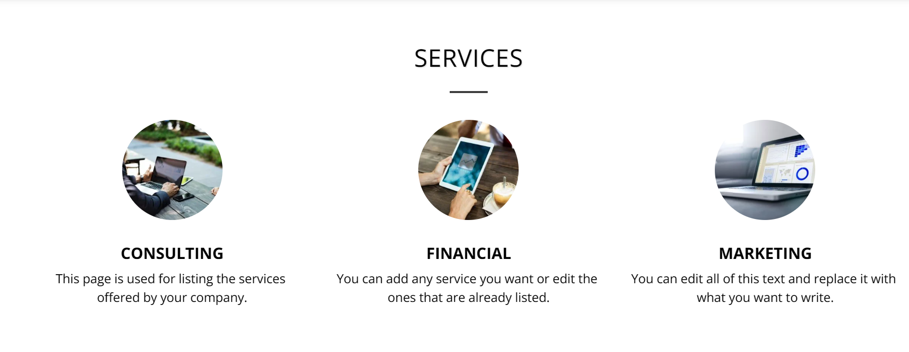
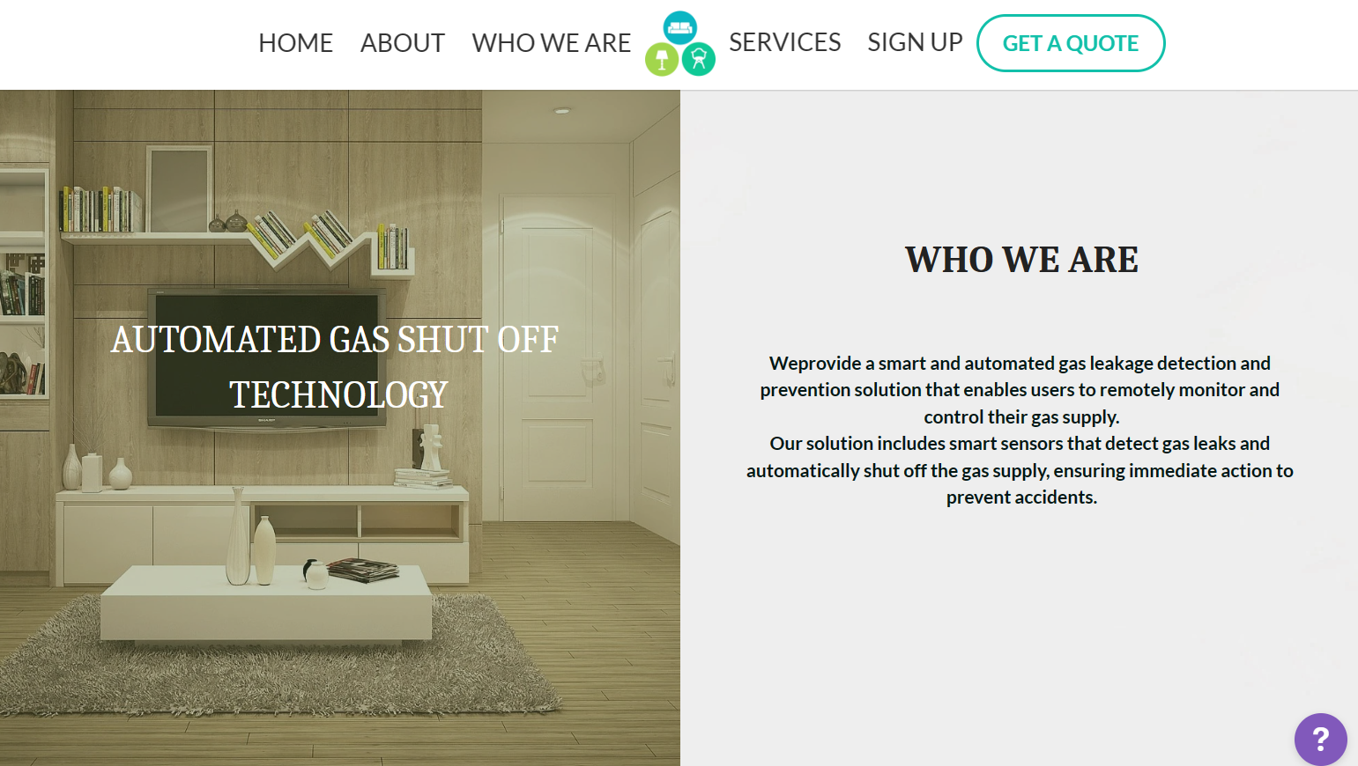
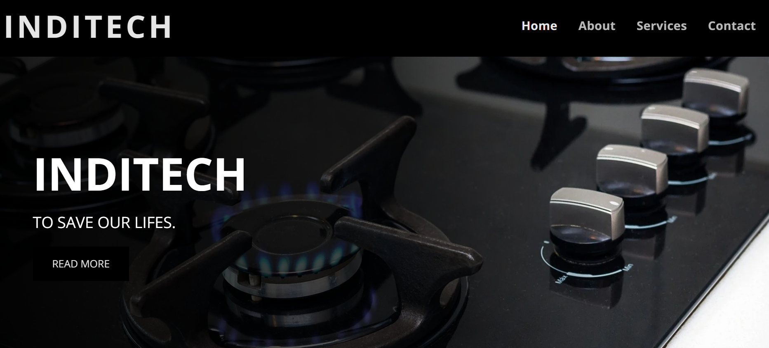
MVP – Website Prototype
Website Link

Slide 19
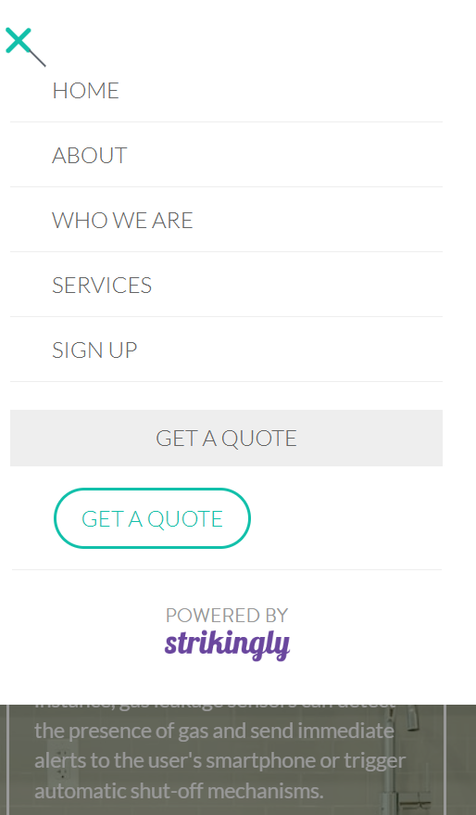
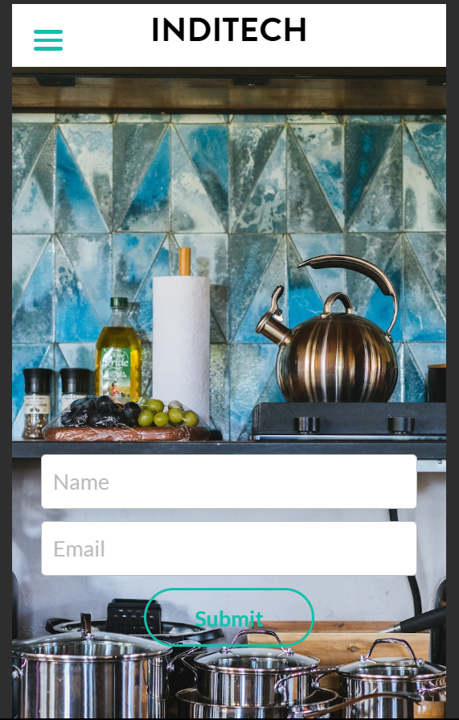
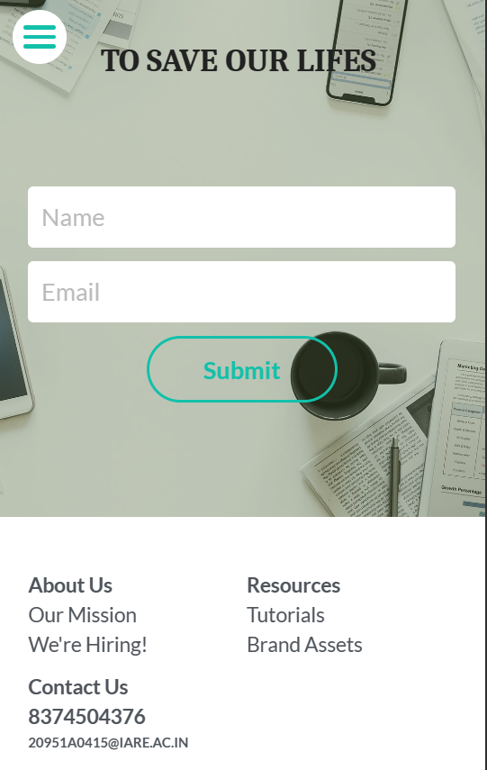
MVP-App View
Website Link

Slide 20
MVP Validation
The prospective customer provided positive feedback on the visual appeal, ease of navigation, user-friendliness of the auto shut off system, information provided, likelihood of recommending the website, and overall performance of the product.
Data Link

Slide 21
FINANCE

Slide 22
Start-Up Costs
Starting Costs
Startup Cost | ₹ 5,00,000
Legal and Administrative fees | ₹ 1,00,000
Leasehold Improvements (minimal remodeling, painting etc.) + Manufacture costs | ₹ 50,000
Device making and patenting | ₹ 2,00,000
Licenses and Permits | ₹ 50,000
Offlce furniture | ₹ 1,00,000
Capital Work in Progress ( Fixed Asset ) | ₹ 2,00,000
Contingency Fund | ₹ 2,00,000
Starting Operations ( Budgeted ) | ₹ 8,50,000
Marketing and branding | ₹ 2,00,000
Rent and utilities | ₹ 2,00,000
Salaries | ₹ 2,00,000
Travel Cost | ₹ 90,000
Electricity | ₹ 60,000
Insurance | ₹ 40,000
Maintenance and repairs | ₹ 40,000
Renters' Association or Business Improvement District fees | ₹ 20,000
Start-up capital | ₹ 15,50,000
Share Captial (by Team) | ₹ 15,50,000
Loans (from Bank or Others) | ₹ -
Explanation:
Founders invest Rs. 1550000 in this venture. They are building the product in their college and taking help form their mentors.
This financial statement talks about their product that sells at Rs. 7000/-
Financial Sheet Link

Slide 23
Forecast Profit And Loss Statement
Profit & Loss Account ( Income Statement)
 | Jan | Feb | Mar | Apr | May | Jun | Jul | Aug | Sep | Oct | Nov | Dec | Totals
Sales
Cash Sales | ₹ 35,000 | ₹ 70,000 | ₹ 1,05,000 | ₹ 2,10,000 | ₹ 3,15,000 | ₹ 4,20,000 | ₹ 5,60,000 | ₹ 7,00,000 | ₹ 8,40,000 | ₹ 9,10,000 | ₹ 9,80,000 | ₹ 10,29,000 | ₹ 61,74,000
No. of Subscription sold | 5 | 10 | 15 | 30 | 45 | 60 | 80 | 100 | 120 | 130 | 140 | 147 | 882
Other Cash Receipts
Average price per subscription | ₹ 7,000 | ₹ 7,000 | ₹ 7,000 | ₹ 7,000 | ₹ 7,000 | ₹ 7,000 | ₹ 7,000 | ₹ 7,000 | ₹ 7,000 | ₹ 7,000 | ₹ 7,000 | ₹ 7,000 | ₹ 7,000
Total Sales | ₹ 35,000 | ₹ 70,000 | ₹ 1,05,000 | ₹ 2,10,000 | ₹ 3,15,000 | ₹ 4,20,000 | ₹ 5,60,000 | ₹ 7,00,000 | ₹ 8,40,000 | ₹ 9,10,000 | ₹ 9,80,000 | ₹ 10,29,000 | ₹ 61,74,000
COGS
Total Cost Per Subscription | ₹ 18,500 | ₹ 37,000 | ₹ 55,500 | ₹ 1,11,000 | ₹ 1,66,500 | ₹ 2,22,000 | ₹ 2,96,000 | ₹ 3,70,000 | ₹ 4,44,000 | ₹ 4,81,000 | ₹ 5,18,000 | ₹ 5,43,900 | ₹ 32,63,400
Cost Per Subscription | ₹ 3,700 | ₹ 3,700 | ₹ 3,700 | ₹ 3,700 | ₹ 3,700 | ₹ 3,700 | ₹ 3,700 | ₹ 3,700 | ₹ 3,700 | ₹ 3,700 | ₹ 3,700 | ₹ 3,700 | ₹ 3,700
Gross profit | ₹ 16,500 | ₹ 33,000 | ₹ 49,500 | ₹ 99,000 | ₹ 1,48,500 | ₹ 1,98,000 | ₹ 2,64,000 | ₹ 3,30,000 | ₹ 3,96,000 | ₹ 4,29,000 | ₹ 4,62,000 | ₹ 4,85,100 | ₹ 29,10,600
Fixed Expenses
Salaries | ₹ 30,000 | ₹ 30,000 | ₹ 30,000 | ₹ 45,000 | ₹ 45,000 | ₹ 45,000 | ₹ 55,000 | ₹ 55,000 | ₹ 55,000 | ₹ 55,000 | ₹ 55,000 | ₹ 55,000 | ₹ 5,55,000
Marketing and Promotion | ₹ 20,000 | ₹ 20,000 | ₹ 20,000 | ₹ 20,000 | ₹ 20,000 | ₹ 20,000 | ₹ 20,000 | ₹ 20,000 | ₹ 20,000 | ₹ 20,000 | ₹ 20,000 | ₹ 20,000 | ₹ 2,40,000
Travel Cost | ₹ 10,000 | ₹ 10,000 | ₹ 10,000 | ₹ 10,000 | ₹ 10,000 | ₹ 10,000 | ₹ 10,000 | ₹ 10,000 | ₹ 10,000 | ₹ 10,000 | ₹ 10,000 | ₹ 10,000 | ₹ 1,20,000
Electricity | ₹ 10,000 | ₹ 10,000 | ₹ 10,000 | ₹ 10,000 | ₹ 10,000 | ₹ 10,000 | ₹ 10,000 | ₹ 10,000 | ₹ 10,000 | ₹ 10,000 | ₹ 10,000 | ₹ 10,000 | ₹ 1,20,000
Maintenance and repairs cost | ₹ 5,000 | ₹ 5,000 | ₹ 5,000 | ₹ 5,000 | ₹ 5,000 | ₹ 5,000 | ₹ 5,000 | ₹ 5,000 | ₹ 5,000 | ₹ 5,000 | ₹ 5,000 | ₹ 5,000 | ₹ 60,000
Insurance and Rent | ₹ 20,000 | ₹ 20,000 | ₹ 20,000 | ₹ 20,000 | ₹ 20,000 | ₹ 20,000 | ₹ 20,000 | ₹ 20,000 | ₹ 20,000 | ₹ 20,000 | ₹ 20,000 | ₹ 20,000 | ₹ 2,40,000
Renters' association & Miscellaneous | ₹ 7,000 | ₹ 7,000 | ₹ 7,000 | ₹ 7,000 | ₹ 7,000 | ₹ 7,000 | ₹ 7,000 | ₹ 7,000 | ₹ 7,000 | ₹ 7,000 | ₹ 7,000 | ₹ 7,000 | ₹ 84,000
Total Expenses | ₹ 1,02,000 | ₹ 1,02,000 | ₹ 1,02,000 | ₹ 1,17,000 | ₹ 1,17,000 | ₹ 1,17,000 | ₹ 1,27,000 | ₹ 1,27,000 | ₹ 1,27,000 | ₹ 1,27,000 | ₹ 1,27,000 | ₹ 1,27,000 | ₹ 14,19,000
Result
Net Profit/Loss | ₹ -85,500 | ₹ -69,000 | ₹ -52,500 | ₹ -18,000 | ₹ 31,500 | ₹ 81,000 | ₹ 1,37,000 | ₹ 2,03,000 | ₹ 2,69,000 | ₹ 3,02,000 | ₹ 3,35,000 | ₹ 3,58,100 | ₹ 14,91,600
Gross Profit Margin | 47% | 47% | 47% | 47% | 47% | 47% | 47% | 47% | 47% | 47% | 47% | 47% | 47%
Net Profit Margin | -244% | -99% | -50% | -9% | 10% | 19% | 24% | 29% | 32% | 33% | 34% | 35% | 24%

Slide 24
Forecast Cash Flow
Cash flow forecast
 | Jan | Feb | Mar | Apr | May | Jun | Jul | Aug | Sep | Oct | Nov | Dec
Starting Cash Position | 10,50,000 | 8,64,500 | 7,95,500 | 7,43,000 | 7,25,000 | 7,56,500 | 8,37,500 | 9,74,500 | 11,77,500 | 14,46,500 | 17,48,500 | 20,83,500
Cash Inflows
Total Sales | 35,000 | 70,000 | 1,05,000 | 2,10,000 | 3,15,000 | 4,20,000 | 5,60,000 | 7,00,000 | 8,40,000 | 9,10,000 | 9,80,000 | 10,29,000
Cash Outflows
Cost Of Goods Sold | 18,500 | 37,000 | 55,500 | 1,11,000 | 1,66,500 | 2,22,000 | 2,96,000 | 3,70,000 | 4,44,000 | 4,81,000 | 5,18,000 | 5,43,900
Operating Expenses | 1,02,000 | 1,02,000 | 1,02,000 | 1,17,000 | 1,17,000 | 1,17,000 | 1,27,000 | 1,27,000 | 1,27,000 | 1,27,000 | 1,27,000 | 1,27,000
New Fixed Assets Purchased | 1,00,000
Additional Inventories Purchased
Loan Payments
Total | 2,20,500 | 1,39,000 | 1,57,500 | 2,28,000 | 2,83,500 | 3,39,000 | 4,23,000 | 4,97,000 | 5,71,000 | 6,08,000 | 6,45,000 | 6,70,900
Result
Change during month | -1,85,500.0 | -69,000.0 | -52,500.0 | -18,000.0 | 31,500.0 | 81,000.0 | 1,37,000.0 | 2,03,000.0 | 2,69,000.0 | 3,02,000.0 | 3,35,000.0 | 3,58,100.0
Closing cash position | 8,64,500.0 | 7,95,500.0 | 7,43,000.0 | 7,25,000.0 | 7,56,500.0 | 8,37,500.0 | 9,74,500.0 | 11,77,500.0 | 14,46,500.0 | 17,48,500.0 | 20,83,500.0 | 24,41,600.0

Slide 25
Balance sheet & Breakeven Analysis
Balance sheet forecast
The numbers reflected on this Balance Sheet are computed as of: | 31st Dec
Assets | ₹ 30,41,600
Current assets | ₹ 24,41,600
Cash in hand | ₹ 24,41,600
Petty cash ( cash lying in office )
Accounts Receivable ( Debtors )
Stock on hand (Inventory)
Other Assets
Fixed assets | ₹ 1,00,000
Ebooks | ₹ 1,00,000
Furniture
Capital Investment ( Startup Capital ) | ₹ 5,00,000
Liabilities | ₹ 30,41,600
Current liabilities | ₹ -
Accounts payable ( Creditors )
Interest payable
Any Other Amounts Owed
Long-term liabilities | ₹ -
Loans from Bank | ₹ -
Loans from Friends and Family
Networth | ₹ 30,41,600
Reserves & Surplus ( Retained Earnings) | ₹ 14,91,600
Equity Share Capital | ₹ 15,50,000
Break-even analysis
Average sales price per unit | ₹ 7,000
Average cost of unit | ₹ 3,700
Gross Profit Margin | 47%
Fixed costs | ₹ 14,19,000
Sales required to break even | ₹ 30,10,000
Number of unit sales to break even | 430
Gross Margin % of Sales
Gross Margin | ₹ 29,10,600
Total Sales | ₹ 61,74,000
Gross Margin/Total Sales | 47%
Total Fixed Expenses
Operating Expenses | ₹ 14,19,000
Breakeven Sales (Annual)
Gross Margin % of Sales | 47%
Total Fixed Expenses | ₹ 14,19,000
Yearly Breakeven Amount | ₹ 30,10,000
Monthly Breakeven Amount | ₹ 2,50,833

Slide 26
Financial Projections and Funding
 | Year 1 | Year 2 | Year 3 | Year 4 | Year 5
Number of sales | 882 | 1323 | 3969 | 15876 | 79380
Value of each sale (Contribution) | ₹ 3,300 | ₹ 3,960 | ₹ 4,752 | ₹ 5,702 | ₹ 6,843
Price Per Unit | ₹ 7,000 | ₹ 8,400 | ₹ 10,080 | ₹ 12,096 | ₹ 14,515
Total revenue | ₹ 61,74,000 | ₹ 1,11,13,200 | ₹ 4,00,07,520 | ₹ 19,20,36,096 | ₹ 1,15,22,16,576
Gross Profit | 2910600 | 5239080 | 18860688 | 90531302 | 543187814
Gross Margin | 47% | 47% | 47% | 47% | 47%
Capital costs
Land and building | N.A. | N.A. | N.A. | N.A. | N.A.
Startup Cost | ₹ 5,00,000 | 0 | 0 | 0 | 0
Capital Work | 100000 | 150000 | 172500 | 207000 | 258750
Total | ₹ 6,00,000 | ₹ 6,60,000 | ₹ 7,59,000 | ₹ 9,10,800 | ₹ 11,38,500
Expenses (Annual)
Salaries | ₹ 5,55,000 | ₹ 8,32,500 | ₹ 12,48,750 | ₹ 18,73,125 | ₹ 28,09,688
Marketing and Promotion | ₹ 2,40,000 | ₹ 3,60,000 | ₹ 5,40,000 | ₹ 8,10,000 | ₹ 12,15,000
Travel Cost | ₹ 1,20,000 | ₹ 1,80,000 | ₹ 2,70,000 | ₹ 4,05,000 | ₹ 6,07,500
Electricity | ₹ 1,20,000 | ₹ 1,80,000 | ₹ 2,70,000 | ₹ 4,05,000 | ₹ 6,07,500
Maintenance and repairs cost | ₹ 60,000 | ₹ 90,000 | ₹ 1,35,000 | ₹ 2,02,500 | ₹ 3,03,750
Insurance and Rent | ₹ 2,40,000 | ₹ 3,60,000 | ₹ 5,40,000 | ₹ 8,10,000 | ₹ 12,15,000
Renters' association & Miscellaneous | ₹ 84,000 | ₹ 1,26,000 | ₹ 1,89,000 | ₹ 2,83,500 | ₹ 4,25,250
Total Expenses | ₹ 14,19,000 | ₹ 21,28,500 | ₹ 31,92,750 | ₹ 47,89,125 | ₹ 71,83,688
EBITDA | ₹ 14,91,600 | ₹ 31,10,580 | ₹ 1,56,67,938 | ₹ 8,57,42,177 | ₹ 53,60,04,127
Based on the projections done, we don’t need to raise external funds now.

Slide 27
Unit Economics
P & L/ unit | Year 1 |  | Unit Economics | Year 1 |  |  | Step 1 | APV = Average Purchase Value = Total revenue/Total number of purchases | ₹ 7,000
Revenue | ₹ 7,000 |  | CAC | ₹ 272 |  |  | Step 2 | APF = Average Purchase Frequency = Number of purchases/ Number of unique customers | 1
COGS | ₹ 3,700 |  | CLV | ₹ 3,438 |  |  | Step 3 | Average Customer Lifespan = 1/Churnrate | 1.04
Gross Profit | ₹ 3,300 |  | ARPU | ₹ 7,000 |  |  | Step 4 | CLV =APV*APF*ACL*GM | ₹ 3,438
Gross Profit Margin | 47%
Operating Costs | ₹ 5309
Operating Profit | ₹ 1691
CAC​ | (Cost of Sales + Cost of Marketing ) / Number of new customers acquired (in currency terms)​
CLV | Average purchase value x Average purchase frequency x Average Customer Lifespan x Gross Margin
ARPU​ | Total revenue in specific period/Total number of customers during the same period (in currency terms)​
GROSS PROFIT​ | Total revenue – Total COGS (In currency terms)​
OPERATING COSTS | Cost of goods sold (COGS) + operating expenses (OPEX)
OPERATING PROFIT | Revenue from Core Operations – Cost of Goods Sold – Operating Expenses – Depreciation – Amortization Expenses (Depreciations and Amortization expenses are assumed 0 in this case)
CHURN RATE | (Customers at the beginning of the period – customers at the end of the period) / customers at the beginning of the period

Slide 28
Sales Funnel
Awareness Stage:
Leads: 700,000 (NicheTarget Market Size)
Niche Segment: 7% of 700,000 = 49,000
Interest Stage:
Leads: 49,000
Conversion Rate: 30%
Potential Customers: 49,000 * 0.30 = 14,700
Consideration Stage:
Potential Customers: 14,700
Conversion Rate: 20%
Qualified Leads: 14,700 * 0.20 = 2,940
Purchase Stage:
Qualified Leads: 2,940
Conversion Rate: 30%
Paying Customers: 2,940 * 0.30 = 882
Awareness
49K
Interest​
14.7K
Consideration​
2940
Customer​
882

Slide 29
Target Market: Focus on households and businesses with gas connections, particularly in urban areas.
Marketing Channels: Utilize a combination of online and offline channels to reach the target audience. This includes digital marketing campaigns, social media presence, partnerships with gas suppliers/dealers or service providers, and participation in relevant industry events or trade shows.
Sales Approach: Employ a direct sales approach, engaging with potential customers through personalized demonstrations, consultations, and product trials. Leverage customer testimonials and referrals to build trust and credibility.
Pricing Strategy: Adopt a competitive pricing strategy that offers value for money while considering the affordability and willingness to pay of the target market. Consider offering flexible payment options or subscription models to enhance customer convenience.
Customer Support: Provide exceptional customer support through various channels such as phone, email, and live chat. Offer comprehensive product training, troubleshooting guides, and prompt resolution of customer queries or concerns.
GTM (Go-To-Market) Strategy

Slide 30
Brand Framework
Brand Identity
Brand Messaging
Brand Voice
Brand Differentiation
Brand Awareness
Customer Engagement
Develop a brand identity that reflects the key values of safety, reliability, and convenience. Use a combination of colors, typography, and visuals that voke trust, security, and modernity.
Craft a clear and compelling brand message that emphasizes the importance of gas safety and the role of the company in providing reliable solutions. Highlight the benefits of peace of mind, protection, and the ease of use that the product offers.
Establish a consistent brand voice that is informative, friendly, and empathetic. Communicate the brand's expertise, commitment to customer safety, and dedication to delivering excellent user experiences.
Highlight the unique features and advantages of the product compared to competitors. Emphasize the advanced technology, accuracy, ease of installation, and user-friendly interface that sets your solution apart
Implement targeted marketing campaigns to raise brand awareness and reach the target audience effectively. Leverage social media platforms, online advertising, content marketing, and strategic partnerships to expand the brand's visibility and reach.
Foster strong customer relationships by engaging with customers through social media platforms, email newsletters, and educational content. Encourage customer feedback, reviews, and testimonials to build trust and credibility.

Slide 31
Branding, Positioning and Channels
Brand Logo
Positioning Statement
For homeowners and businesses concerned about gas leakage hazards, IndiTech offers an innovative solution that provides real-time detection, instant alerts, and prompt response to ensure the safety and well-being of occupants. Unlike traditional gas detectors, our advanced technology combines smart sensors, cloud connectivity, and a user-friendly mobile app to deliver reliable and convenient gas leak monitoring. With IndiTech, you can have peace of mind knowing that your premises are protected from the dangers of gas leaks, enabling a safer environment for everyone.
Channels
Online marketing and advertising
Partnerships with gas stove dealers
Social media presence

Slide 32



Team Composition
GURRAM ANKIT
MD ARSHAD AYUB
PARIYADA MAHESH
What makes us a good team to solve the problem we chose?
Our team is truly exceptional and has all the qualities that make it great. First and foremost, our team members possess diverse skills and expertise, covering a wide range of areas.
This diversity allows us to tackle challenges from multiple perspectives, ensuring comprehensive problem-solving and innovative ideas. Moreover, our team members exhibit exceptional collaboration and communication skills.
We have fostered an environment of trust and respect, where everyone's opinions are valued and heard. This open and inclusive culture promotes effective teamwork, boosts creativity, and enhances productivity. Additionally, each team member brings a high level of commitment and dedication to the table.
We share a common vision and work towards achieving our goals with unwavering determination. Moreover, our team thrives on mutual support and encouragement. We celebrate each other's successes and provide assistance whenever needed.
This strong support system creates a positive and motivating atmosphere, fueling individual growth and team cohesion. Our ability to embrace change and learn from failures allows us to continuously improve and achieve outstanding results.
In conclusion, our team's diverse expertise, strong communication, collaborative spirit, commitment, support, adaptability, and resilience make us truly outstanding and capable of overcoming any obstacle that comes our way.
Role/Position:
CEO
Role/Position:
COO/CTO
Role/Position:
CFO/CMO
Key Strengths and abilities :
He is penultimate student of IARE in the branch of Electronics and Communication Engineering. He is an effective communicator. He has excellent technical capabilities and is adaptable to all kinds of circumstances.
Key Strengths and abilities :
He is penultimate student of IARE in the branch of Electronics and Communication Engineering. He is a motivated and effective learner. A
good socializer. client relation manager a pullulate pvt limited.
Key Strengths and abilities :
He is penultimate student of IARE in the branch of Electronics and Communication Engineering . He has a strong sense of purpose and
an excellent leader. He has a quick memory.

Slide 33
Thank You

